Slide 1

SRM INSTITUTE OF SCIENCE AND TECHNOLOGY FACULTY OF ENGINEERING AND TECHNOLOGY
18CSS101J- PROGRAMMING FOR PROBLEM SOLVING MINI PROJECT REPORT
PROJECT TITTLE -
EMPLOYEE RECORD MANAGEMENT SYSTEM
Submitted by:
Name & Reg. No – Monika Maradana RA2111033010158
Name & Reg. No – Shreyas Gupta RA2111030010289
Name & Reg. No- Joshua Nathaneal RA2111027010207
Branch: CSE
Section: Z2

Slide 2
TABLE OF CONTENTS
Title
Page Number
1) Abstract…………………………………………………....3
2) Problem Statement…………………………………….......4
3) Description…………………………………….…….…….5
4) Objective……………………………..………….………...6
5) Algorithm………………………………………..….……..7
6) Flowchart……………………………………………..……8
7) Code………………………………………………………..9
8) Result………………………………...…………….………17
9)Conclusion…………………………………………………..17

Slide 3
ABSTRACT
The project employee management system using C manages employee records using the file system. this help to register employee, display all list of an employee on the screen, search a particular employee record, modify and delete information of an employee. The best part of this project is it uses graphics to more look like real software designed in other higher-level programming languages.

Slide 4
PROBLEM STATEMENT
In this C Project we are going to cover create Employee Management System with C language. With this Employee Management System, we can manage the details of the employees working in a company or organization. Insert, Edit, and Delete file operations are used in this project, but the limitation of this project is that you can only list the data but cannot search for any data item in particular.

Slide 5
DESCRIPTION:
A Employee’s Management System (EMS) is a software built to handle the primary housekeeping functions of a company. EMS help companies keep track of all the employees and their records. It is used to manage the company using computerized system.
Aim of Employee’s Management System:
Built The Employee Table.
Insert New Entries.
Delete The Entries.
Search A Record.

Slide 6
OBJECTIVE:
The main objective of the system is to computerize the maintenance of the employee details and salary section in the company. Insert, Edit, and Delete file operations are used in this project, but the limitation of this project is that you can only list the data but cannot search for any data item in particular. You can include the searching techniques in c to modify this program if you have better knowledge.

Slide 7
ALGORITHM:
For storing the data of the employee, create a user define datatype which will store the information regarding Employee.
For building the employee table the idea is to use the array of the above struct datatype which will use to store the information regarding employee.
Since we are using array to store the data, therefore to delete the data at any index shift all the data at that index by 1 and delete the last data of the array by decreasing the size of array by 1.

Slide 8
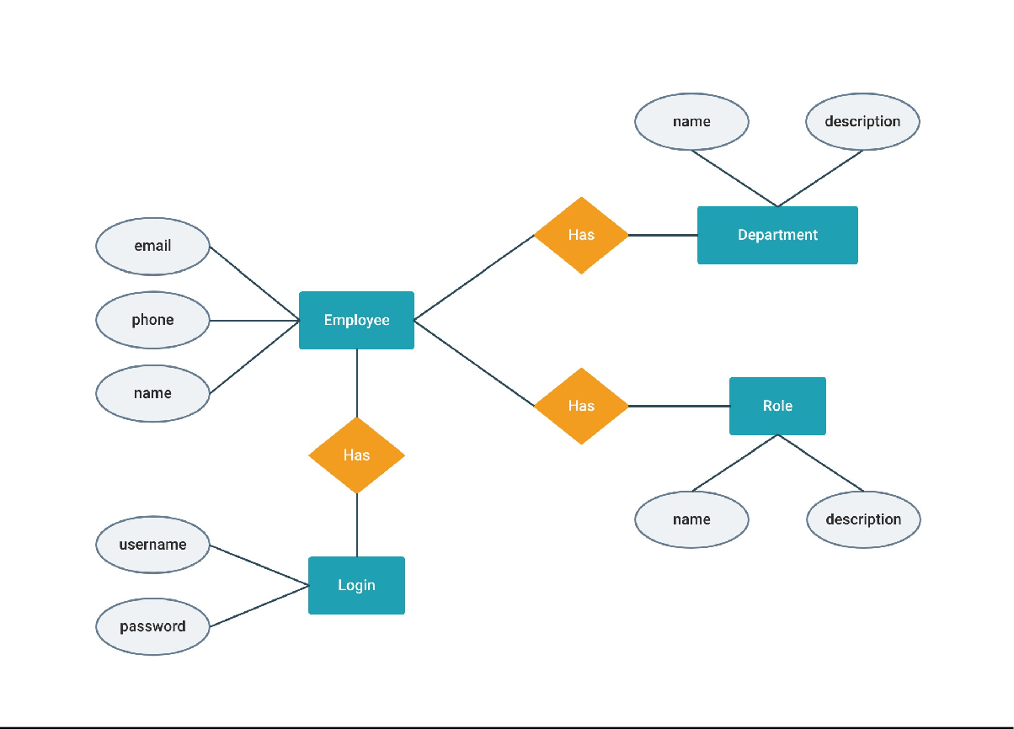
FLOWCHART:

Slide 9
CODE:
#include <stdio.h>
#include <stdlib.h> #include <string.h> #include <windows.h>
// Structure of the employee struct emp {
char name[50]; float salary; int age;
int id;
};
struct emp e;
// size of the structure long int size = sizeof(e);
// In the start coordinates
// will be 0, 0
COORD cord = { 0, 0 };
// function to set the
// coordinates
void gotoxy(int x, int y)
{
cord.X = x; cord.Y = y;
SetConsoleCursorPosition( GetStdHandle(STD_OUTPUT_HANDLE), cord);
}
FILE *fp, *ft;
// Function to add the records void addrecord()
{
system("cls"); fseek(fp, 0, SEEK_END); char another = 'y';
while (another == 'y') { printf("\nEnter Name : "); scanf("%s", e.name);
printf("\nEnter Age : ");

Slide 10
scanf("%d", &e.age);
printf("\nEnter Salary : "); scanf("%f", &e.salary);
printf("\nEnter EMP-ID : "); scanf("%d", &e.id);
fwrite(&e, size, 1, fp); printf("\nWant to add another"
" record (Y/N) : "); fflush(stdin);
scanf("%c", &another);
}
}
// Function to delete the records void deleterecord()
{
system("cls"); char empname[50]; char another = 'y';
while (another == 'y') { printf("\nEnter employee "
"name to delete : "); scanf("%s", empname);
ft = fopen("temp.txt", "wb"); rewind(fp);
while (fread(&e, size,
1, fp)
== 1) {
if (strcmp(e.name,
empname)
!= 0)
fwrite(&e, size, 1, ft);
}
fclose(fp); fclose(ft); remove("data.txt");
rename("temp.txt", "data.txt");
fp = fopen("data.txt", "rb+");

Slide 11
printf("\nWant to delete another" " record (Y/N) :");
fflush(stdin); another = getche();
}
}
// Function to display the record void displayrecord()
{
system("cls");
// sets pointer to start
// of the file rewind(fp);
printf("\n=========================" "===========================" "======");
printf("\nNAME\t\tAGE\t\tSALARY\t\t" "\tID\n",
e.name, e.age,
e.salary, e.id); printf("==========================="
"==========================="
"====\n");
while (fread(&e, size, 1, fp) == 1) printf("\n%s\t\t%d\t\t%.2f\t%10d",
e.name, e.age, e.salary, e.id);
printf("\n\n\n\t"); system("pause");
}
// Function to modify the record void modifyrecord()
{
system("cls"); char empname[50]; char another = 'y';
while (another == 'y') { printf("\nEnter employee name"
" to modify : "); scanf("%s", empname);
rewind(fp);

Slide 12
// While File is open
while (fread(&e, size, 1, fp) == 1) {
// Compare the employee name
// with ename
if (strcmp(e.name, empname) == 0) { printf("\nEnter new name:"); scanf("%s", e.name); printf("\nEnter new age :"); scanf("%d", &e.age); printf("\nEnter new salary :"); scanf("%f", &e.salary); printf("\nEnter new EMP-ID :"); scanf("%d", &e.id);
fseek(fp, -size, SEEK_CUR); fwrite(&e, size, 1, fp); break;
}
}
// Ask for modifying another record printf("\nWant to modify another"
" record (Y/N) :"); fflush(stdin); scanf("%c", &another);
}
}
// Driver code int main()
{
int choice;
// opening the file
fp = fopen("data.txt", "rb+");
// showing error if file is
// unable to open. if (fp == NULL) {
fp = fopen("data.txt", "wb+");
if (fp == NULL) {
printf("\nCannot open file..."); exit(1);
}
}
system("Color 3F");

Slide 13
printf("\n\n\n\n\t\t\t\t=============" "=============================" "===========");
printf("\n\t\t\t\t~~~~~~~" "~~~~~~~~~~~"
"~~~"); printf("\n\t\t\t\t==================="
"=============================" "=====");
printf("\n\t\t\t\t[|:::>:::>:::>::> " "EMPLOYEE RECORD <::<:::<:::"
"<:::|]\t");
printf("\n\t\t\t\t===================" "=============================" "=====");
printf("\n\t\t\t\t~~~~~~~~" "~~~~~~~~~~"
"~");
printf("\n\t\t\t\t=====================" "==============================\n");
printf("\n\n\n\t\t\t\t\t\t\t\t\t\t"
"\n\n\t\t\t\t");
system("pause"); while (1) {
// Clearing console and asking the
// user for input system("cls"); gotoxy(30, 10);
printf("\n1. ADD RECORD\n"); gotoxy(30, 12);
printf("\n2. DELETE RECORD\n"); gotoxy(30, 14);
printf("\n3. DISPLAY RECORDS\n"); gotoxy(30, 16);
printf("\n4. MODIFY RECORD\n"); gotoxy(30, 18);
printf("\n5. EXIT\n"); gotoxy(30, 20);
printf("\nENTER YOUR CHOICE...\n"); fflush(stdin);
scanf("%d", &choice);
// Switch Case switch (choice) { case 1:

Slide 14
// Add the records addrecord(); break;
case 2:
// Delete the records deleterecord(); break;
case 3:
// Display the records displayrecord(); break;
case 4:
// Modify the records modifyrecord(); break;
case 5:
fclose(fp); exit(0); break;
default:
printf("\nINVALID CHOICE...\n");
}
}
return 0;
}

Slide 15
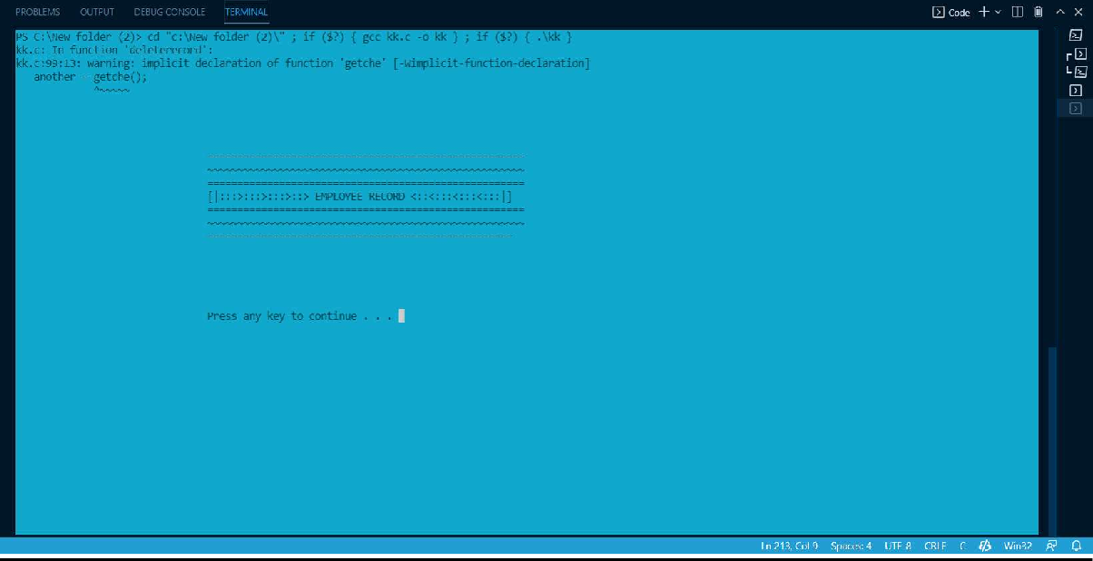
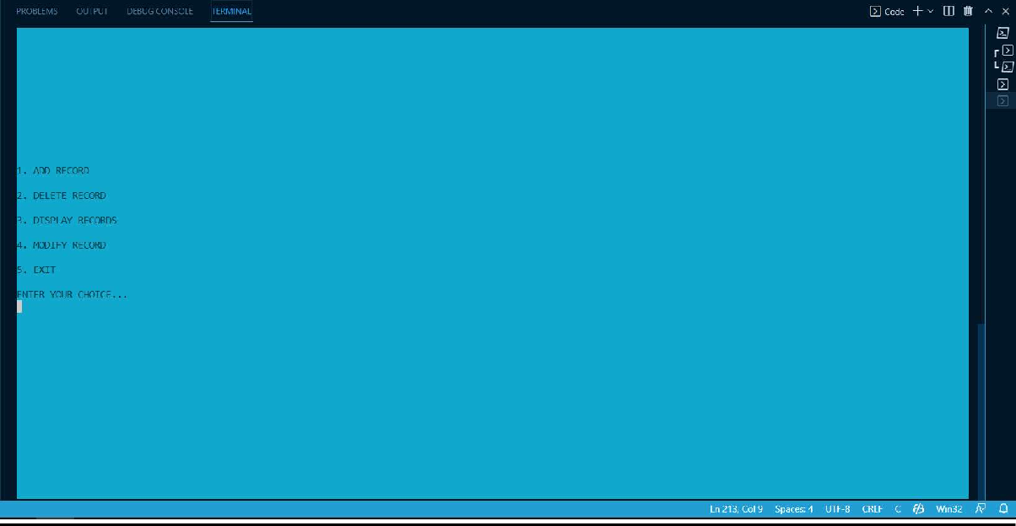
OUTPUT:

Slide 16
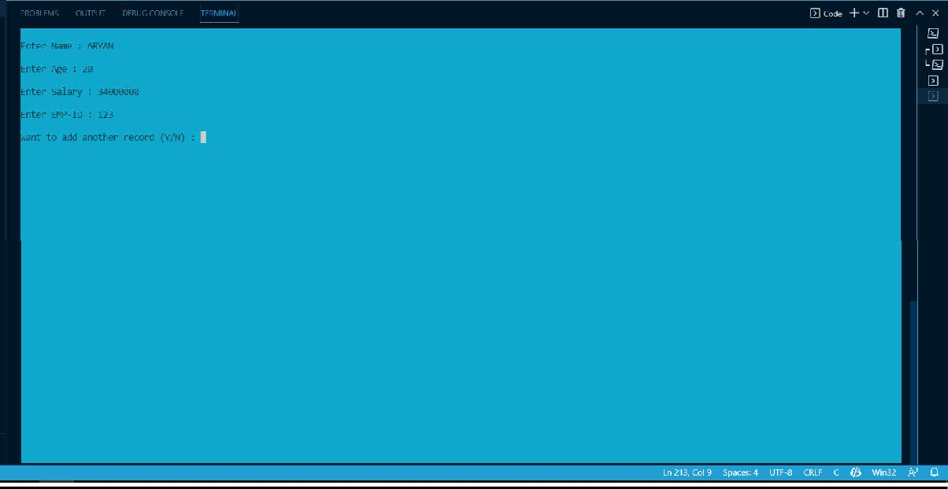
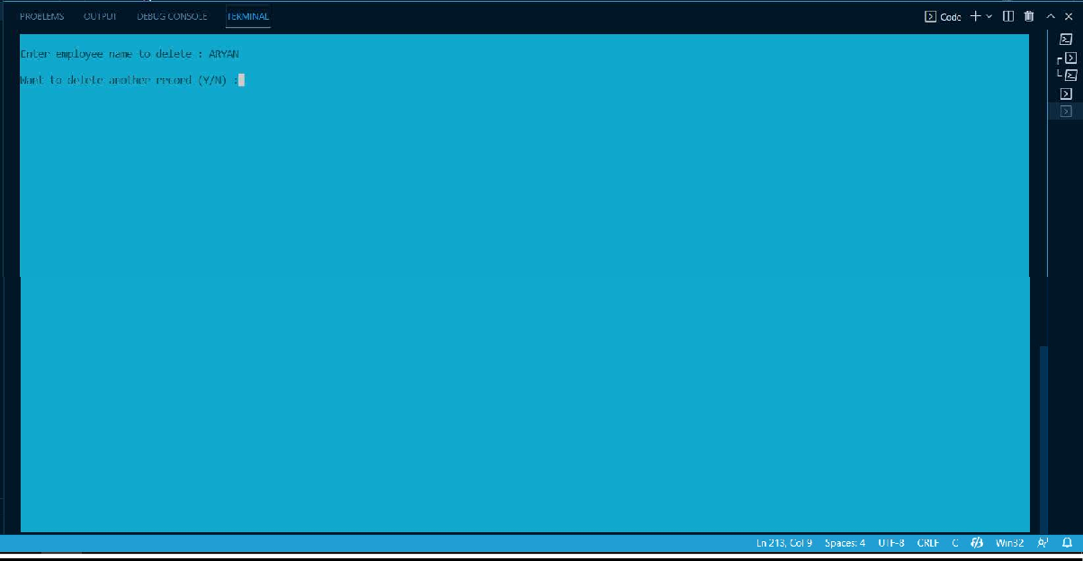

Slide 17
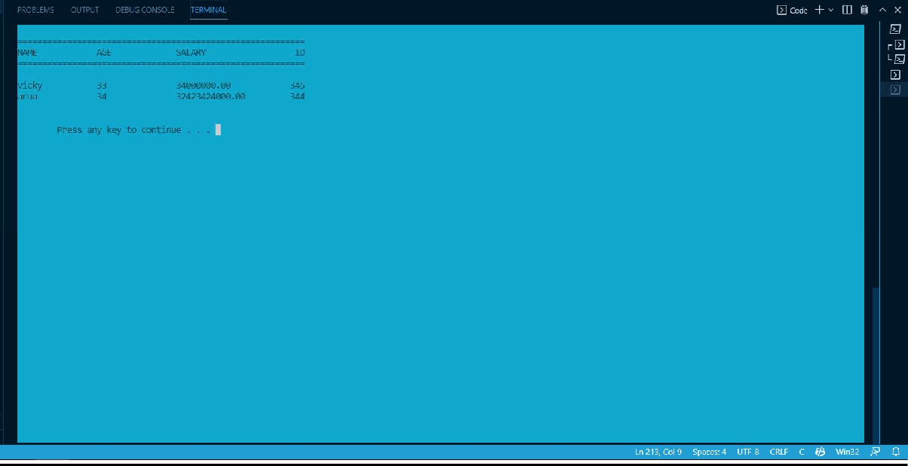
RESULT:
Employee Management system (EMS) is successfully evaluated.
CONCLUSION:
In this C Projects source code series, we create employee Management system (EMS). We can manage the details of the employees working in a company or organization.

